Slide 1
REAL TIME POLLING SYSTEM
By,
Rajashekar Reddy Vemula
Koushik Reddy Sama
Sai Krishna Reddy Katta

Slide 2
Introduction
In this project we are providing a basic interface for public to vote for their favorite IPL player.
We have provided few top players list so that the user can vote only from

Slide 3
Introduction
An electronic polling system allows users cast their votes with ease without the trouble and stress of visiting a Polling booth.
This makes it easily accessible because it will be employed by users anywhere within the world.
Adding Realtime functionality to the applying improves the user experience as votes are seen in Realtime.

Slide 4
Topics To be discussed
The objective of the project
Inspiration from the existing project
How our project is different ?
Architecture
Individual contribution
Project demo
Issues
references

Slide 5
Objectives and details
The objective of the project:
- The main objective of our project is to find the favorite player of the
IPL (Indian premiere league) from the list of players given.
Inspiration from projects:
- It is basically inspired from taking a survey of people before the election.

Slide 6
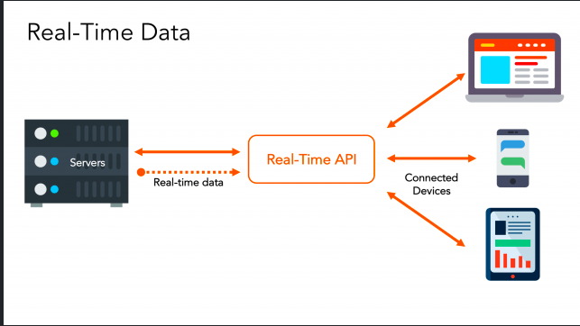
HOW YOUR PROJECT IS DIFFERENT? AND THE ARCHITECTURE
It is quite different from the general elections, here in our project people choose their favorite player from IPL through internet.
The main difference is the results of this poll will be displayed right after the poll ends, where in the general elections they take time to count the votes and announce the results.
Below is the architecture of our project

Slide 7
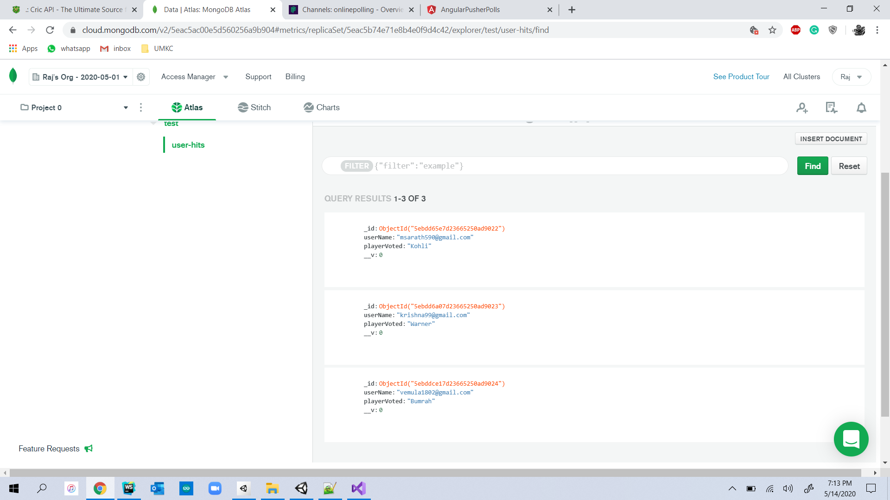
Project output screen shots: Before voting

Slide 8
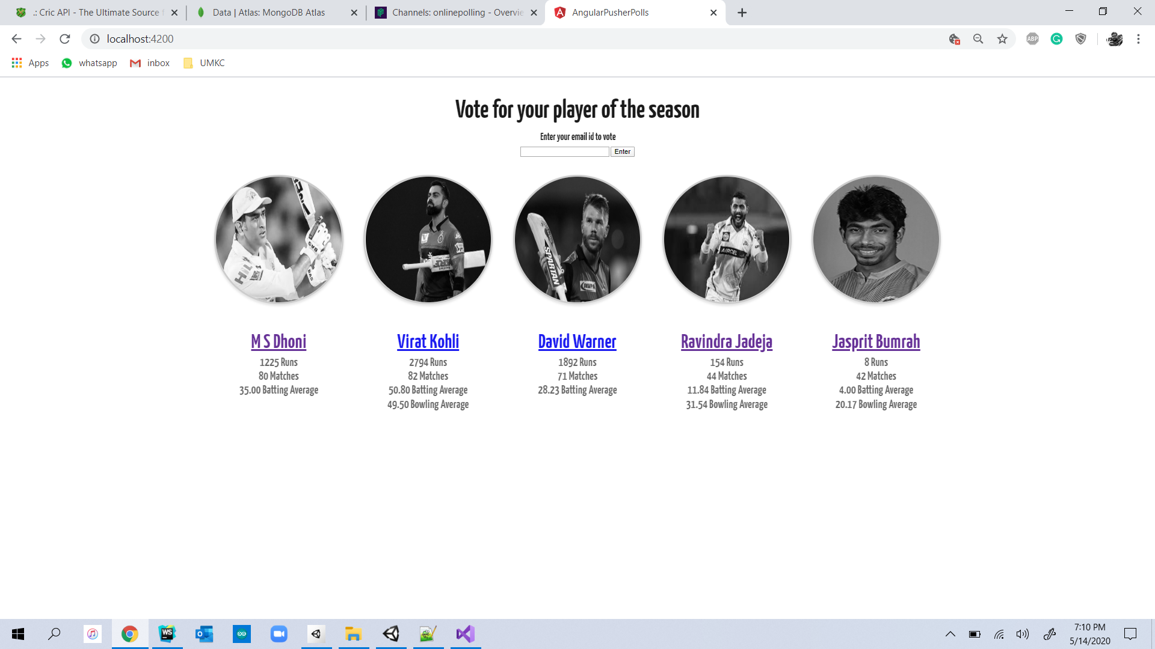
Home page of Real Time Poll System Application

Slide 9
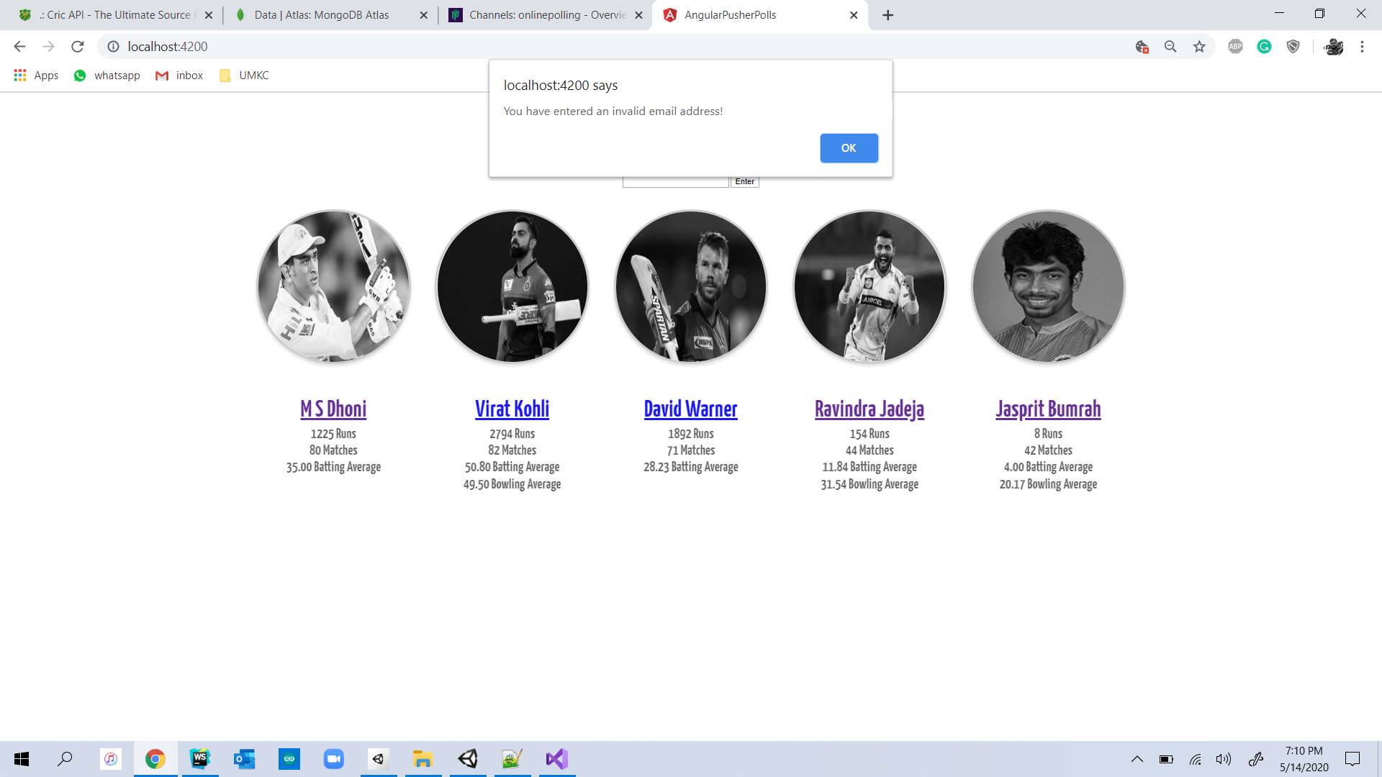
An alert dialog appears when a user tries to vote with blank data in the Email ID column

Slide 10

An alert dialog box appears when a user tries to cast a vote using an invalid Email ID.

Slide 11
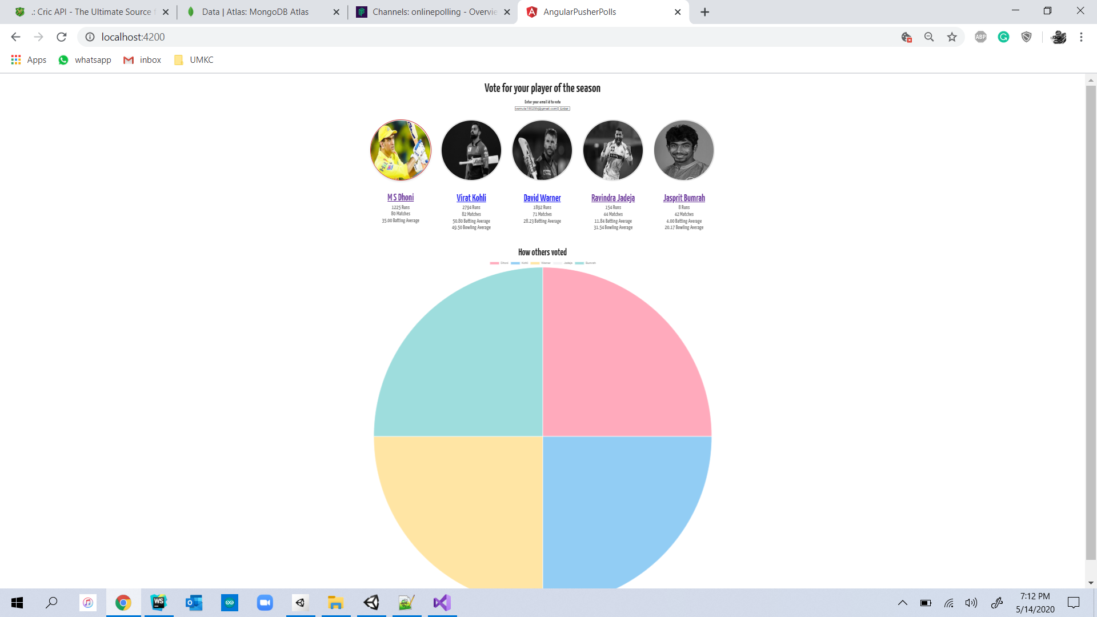
After casting a vote to a player by using a valid Email ID, the voting of each player appears in the form of pie chart. Here the user has casted his vote to player MS Dhoni.

Slide 12
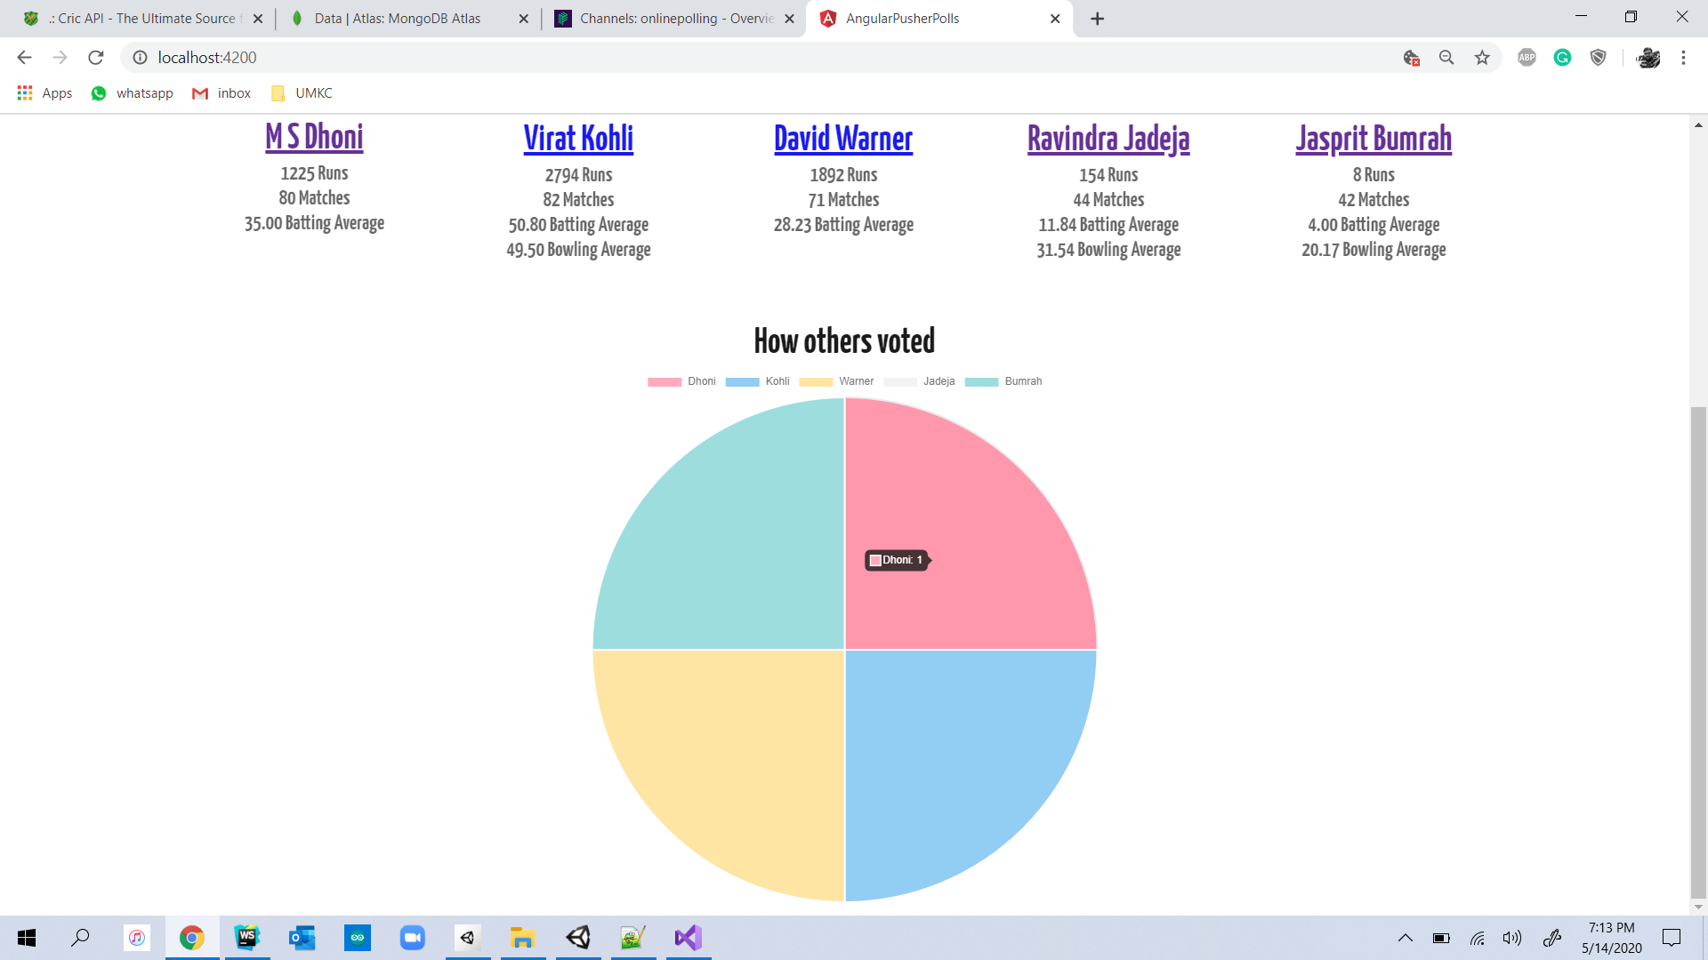
The vote casted to user for MS Dhoni has been displayed in the Pie Chart

Slide 13
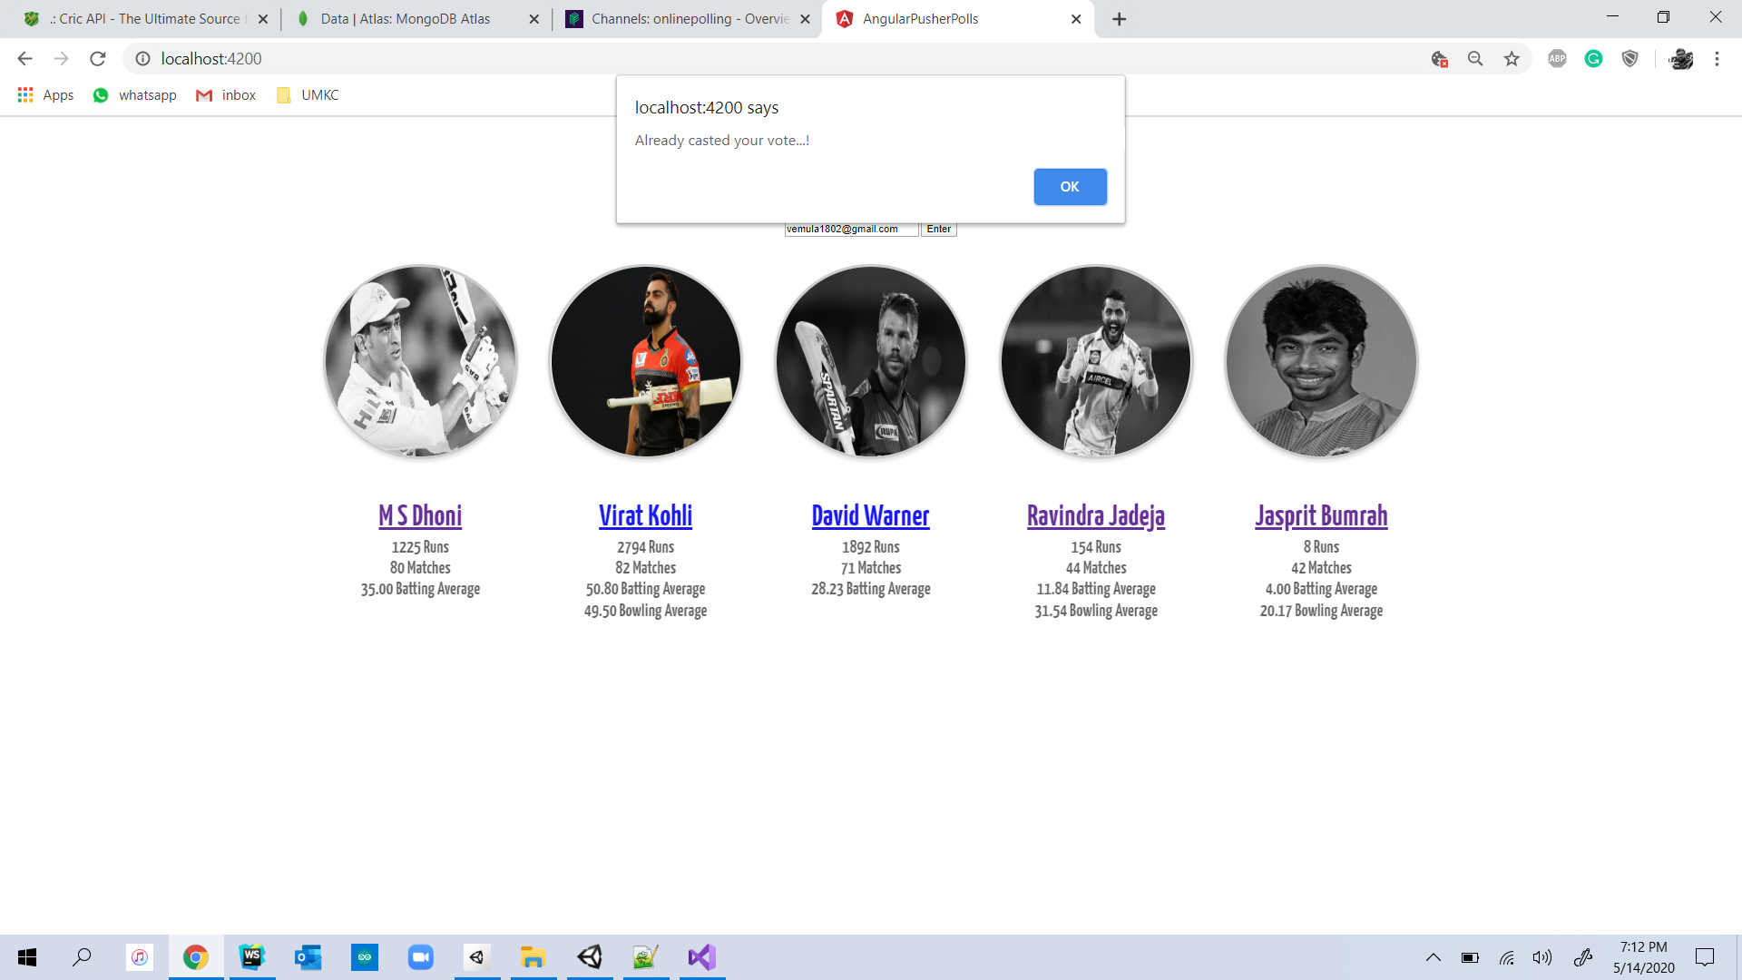
An alert dialog box will appear if user tries to duplicat vote/tries to vote other player using the same Email ID.

Slide 14
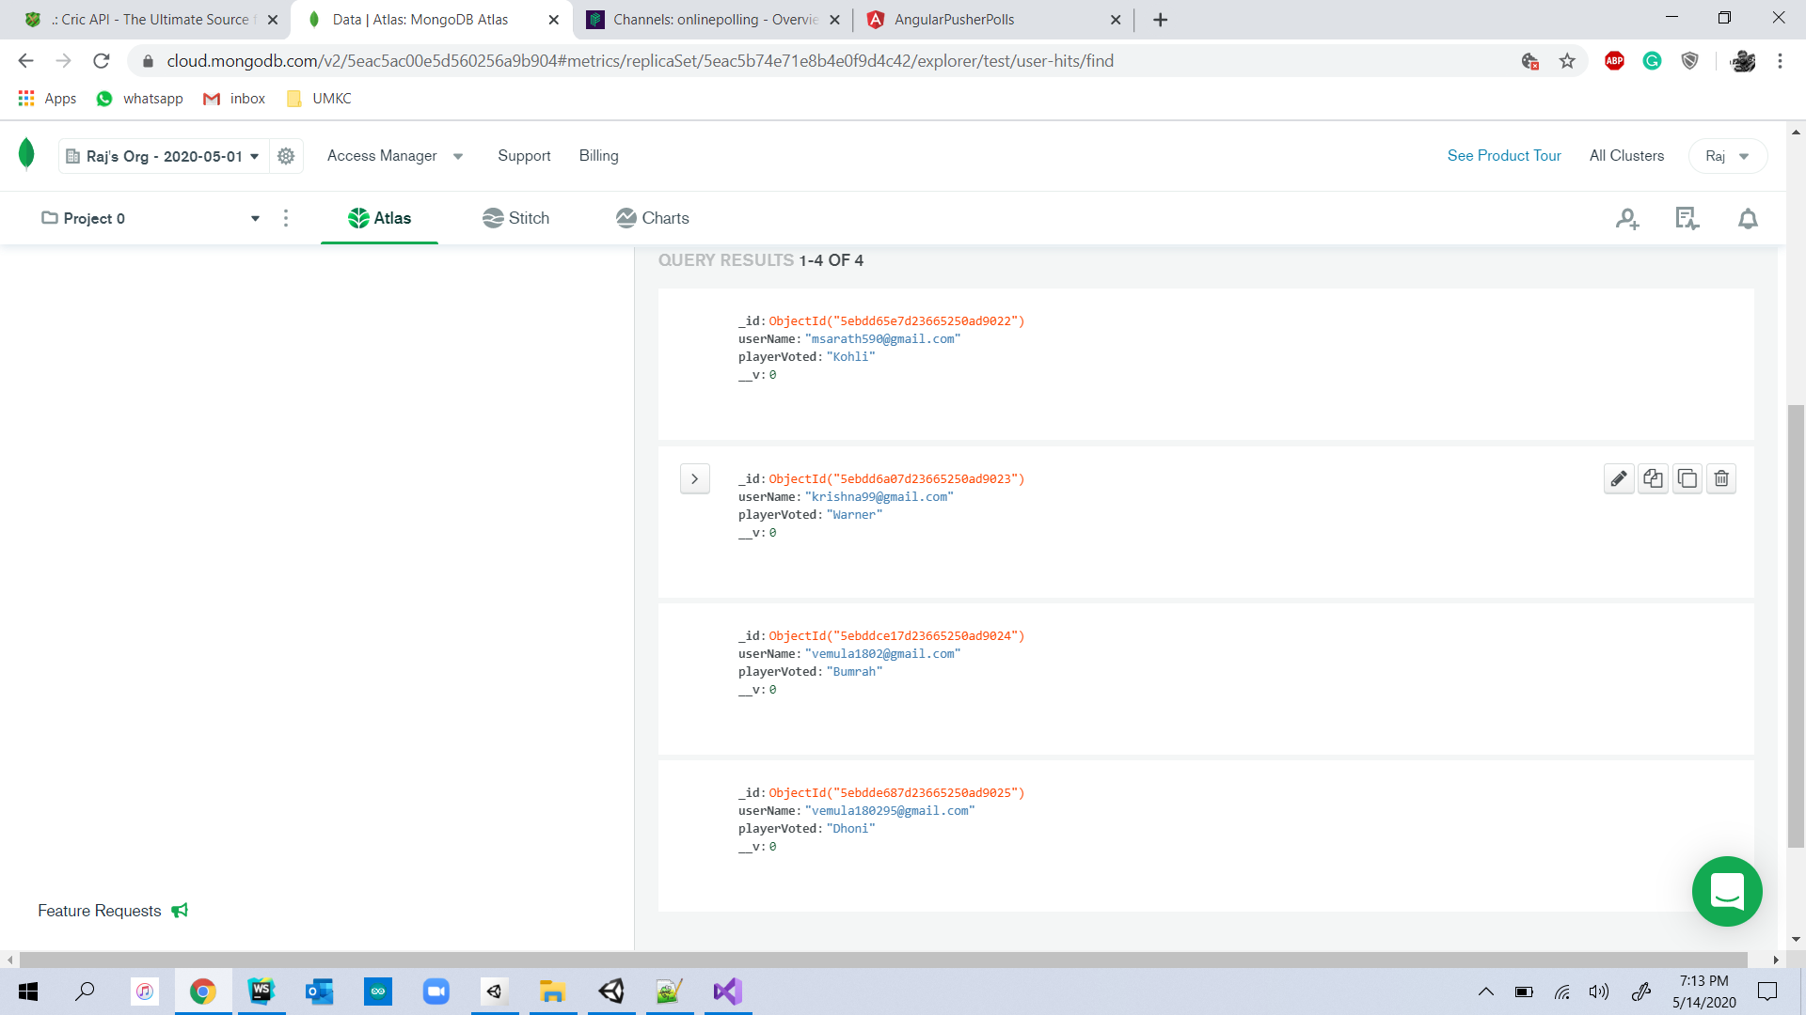
A voting object for player MS Dhoni have been added into MongoDB after successful casting of vote to MS Dhoni by user.

Slide 15
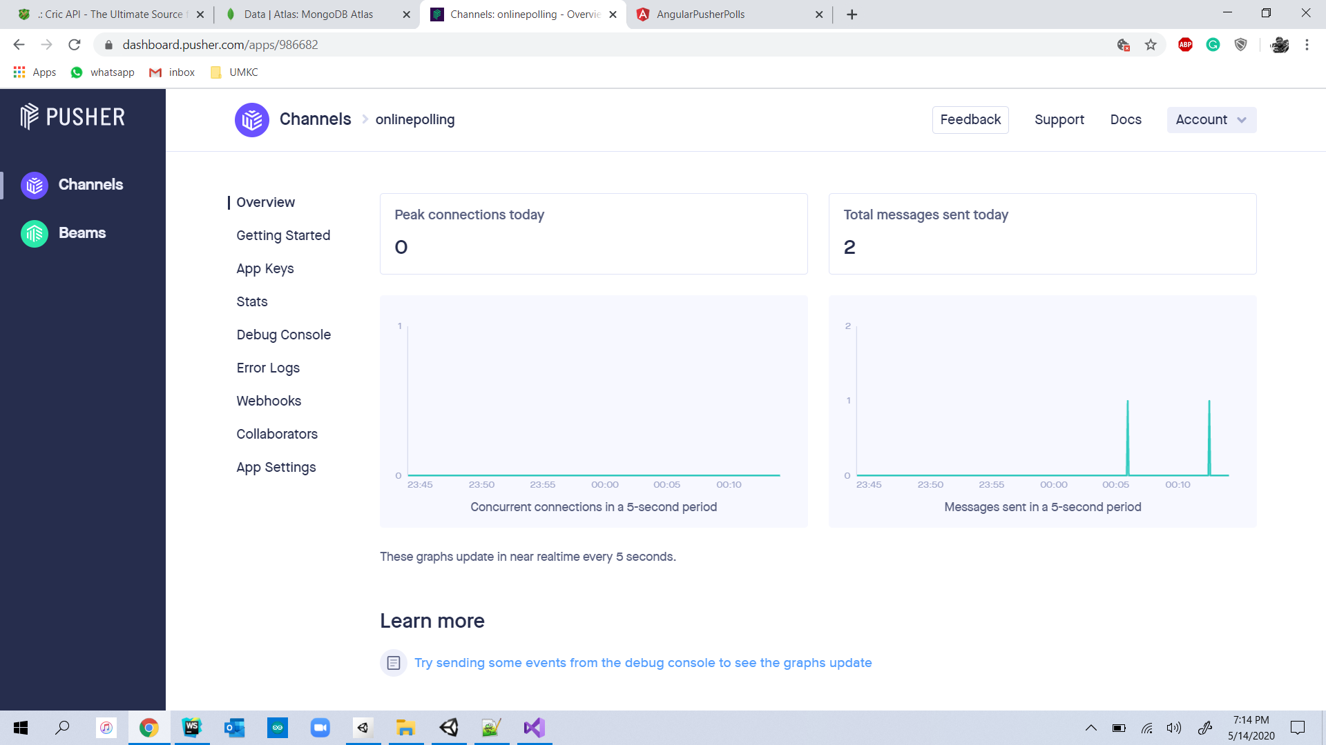
Pusher Dashboard for Real Time Poll System Project

Slide 16
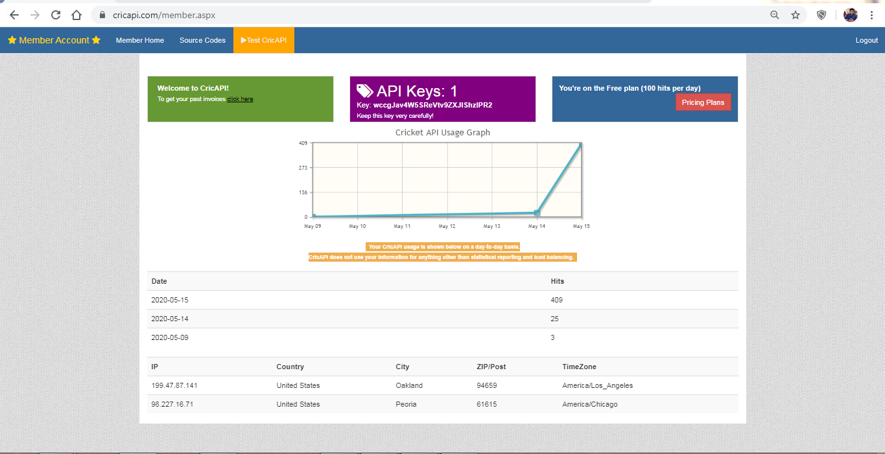
CRIC API Dashboard

Slide 17
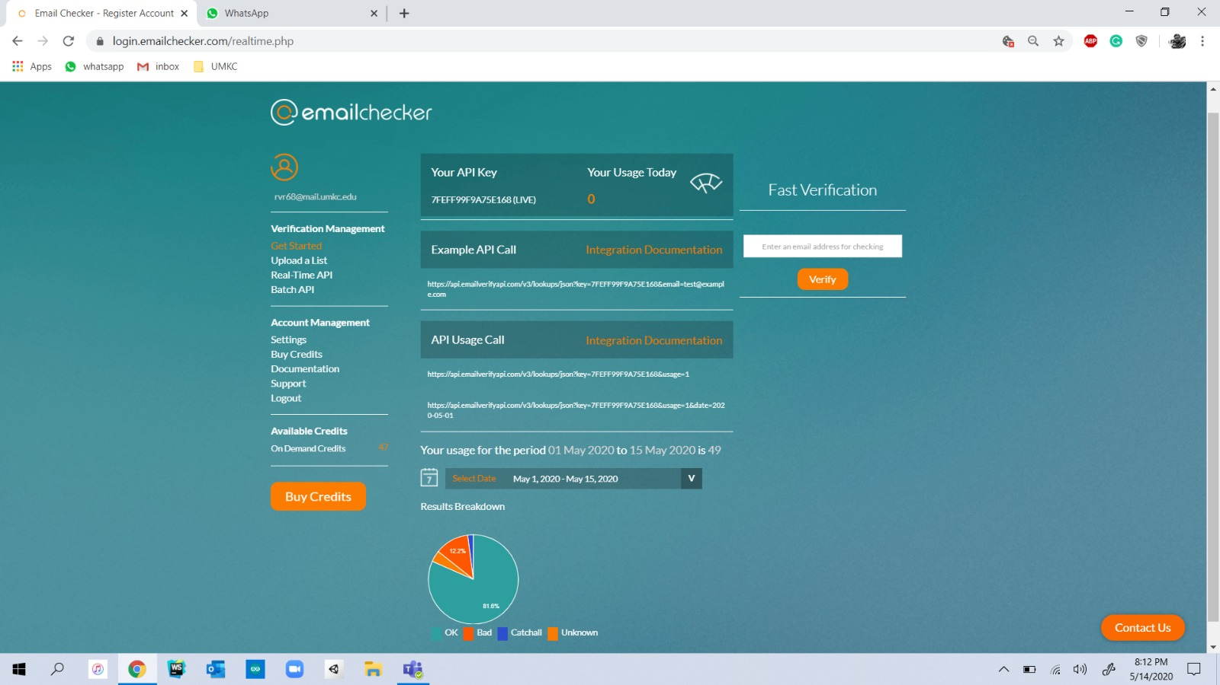
Email Checker API Dashboard

Slide 18
Feedback from Increment-2
Received a Suggestion to add an Email ID to the application for the verification of the user.
Update the player statistics using an API service instead of hardcoded values in the code
Remove the duplication of votes by a user

Slide 19
Improvement from Increment-2
Used API provided by emailchecker.com to validate the Email ID provided by the user. API provided by cricapi.com was used to update the player statistics. Duplication of Votes by a user using a single Email ID has been eliminated by making necessary changes in the code.
GitHub Link for the Project
https://github.com/saikrishnareddykatta/RealTimePollSystem

Slide 20
ISSUES
Web Socket Error while accessing the pusher service.
Single User has chance to duplicate the votes to their favorite player.
Invalid Key Error in pusher service.
Difficulties while creating clusters in the MongoDB.
Receiving the vote count of each player from MongoDB and representing in the form of a pie chart.

Slide 21
References
https://pusher.com/tutorials/
https://www.npmjs.com/package/pusher
https://www.freecodecamp.org/news/how-to-create-an-online-poll-with-asp-net-core-angular-5-and-highcharts-85ff7fecbaf1/
https://www.twilio.com/blog/transfer-files-data-javascript-applications-angular-node-js
https://blog.couchbase.com/creating-front-end-user-profile-store-angular-typescript/
https://www.cricapi.com/
https://www.emailchecker.com/

Slide 22
Work sharing between teammates
Code: Rajashekar - 40%
Koushik Reddy – 30%
Sai Krishna – 30%
PPT – Koushik
Documentation – Sai Krishna

Slide 23


